Slide 1
Google Web Toolkit (GWT)
Basics
Prepared by: Piotr Kosmowski
Submitted on: 07.13.2013
Version: 1.0

Slide 2

Agenda
What are RIA applications and GWT among other technologies
What is GWTProject structure
Client side
Server side
Cross compiler
Building UI
Java based layout
HTML based layout
Declarative way with UI Binder
Productive support tools
Development mode
Super development mode
Client-server comunication
GWT-RPC
Request Builder
Request Factory
Recomendations
GWT ecosystem
Literature

Slide 3
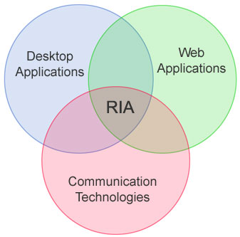
RIA (ang. Rich Internet Application)
History:
Desktop applications
Internet -> Web pages
2001 -> Macromedia -> Flash
AJAX
Contains features of desktop applications:
Single pages applications
No page reloading
Buisness logig mostly on client side
Asynchronious access to server resources
HDuX - High Definition User eXperience:
Widgety, efekty, dźwięk, wideo
Contains features of web applications:
Deployment - Single installation / updates
Doesn’t require disk space (terminals)
Integrates with server (e-mails, SSO, cloud resources)
Cross platform compatibile

Slide 4
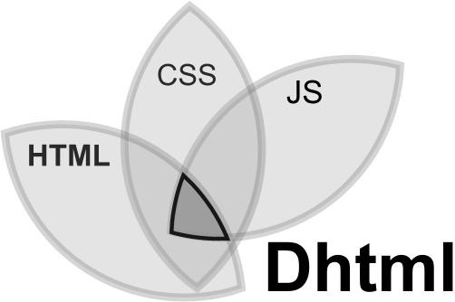




RIA (ang. Rich Internet Application) Technologies, Samples
Most popular technologies:
DHTML = HTML + JavaScript
Silverlight = .NET, need plugins
JavaFX = Java, need VM
Flex = MXML + ActionScript, need plugin
GWT = DHTML in Java
Samples of RIA applications:
Google: Gmail, Docs, Calendar, Maps, Reader, G+
Groveshark, Dropbox, Photoshop.com
Google with GWT: „AdWords, AdSense, Flights, Hotel Finder, Offers, Wallet, The New Blogger, Chrome Webstore, Product Search, Public Data, New Google Groups, Orkut, Google Takeout, Google Pagespeed, Google WebFonts, Google Tables, Google Health (discontinued), Google Wave (discontinued), PlayN (basis of Angry Birds)

Slide 5
Google Web Toolkit (GWT /'gwit/)
Definition
Open source set of tools that allows to create and maintain complex JavaScript front-end applications in JAVA
Toolkit set
Cross compiler
Development mode / Super development mode
JRE emulation library
GWT Web UI class library
…

Slide 6
Google Web Toolkit Features
Open-source
Dynamic and reusable UI components
RPC mechanism / Request Builder / RequestFactory
Browser history management
Support for full-featured Java debugging
GWT handles some cross-browser issues for the developer.
Support for Internationalization and localization
DOM, HTML Canvas support (subject to API changes)
The developers can mix handwritten JavaScript in the Java source code using the JavaScript Native Interface
OOP developing fashion, since they're using Java (instead of JavaScript).
Common JavaScript errors, such as typos and type mismatches, are caught at compile time.
The JavaScript that the GWT compiler generates can be tailored, splitted into modules to be either obfuscated and easy to understand or obfuscated and smaller to download
Resources caching via client bundle
Integration with Java tools, third parties libraries

Slide 7
How to start?
SDK
https://developers.google.com/web-toolkit/
Generate Ant or Maven project
Use extensions
GWT Plugin for Eclipse
Speed Tracer
GWT Designer
Command line tools
Maven archetype
mvn archetype:generate
-DarchetypeGroupId=org.codehaus.mojo
-DarchetypeArtifactId=gwt-maven-plugin
-DarchetypeVersion=2.5.0

Slide 8

How to start with GWT project with Maven?

Slide 9
Project structure
Client side
Server side
HTML Browser
HTML Browser
HTML Browser
Client side
Client side
Client side
GWT pplication
Server
Server side
Data base

Slide 10
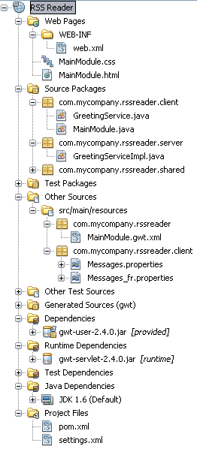
Client side Structure
Static elements
Web Deployment Descriptor
Hosted page
Separated package; default: client
Compiled to JavaScript by cross compiler
Initialized after HTML page (hosted page) is loaded
Limited, emulated environment
Date
Java 1.4
Reflection
Independent from server type
Client components:
Hosted page
Client static resources (images, CSS, JS)
Client bundled resources (images, css)
Main EntryPoint
Module descriptor
Client side
Main Entry Point
Server side
Shared part
Module descriptor
External dependencies
Main configuration file

Slide 11
Client side Hosted page
Hosted page – static HTML page that runs module loader
<!doctype html>
<html>
<head>
<meta http-equiv="content-type" content="text/html; charset=UTF-8">
<link type="text/css" rel="stylesheet" href="SampleGwt.css">
<title>Web Application Starter Project</title>
<script type="text/javascript"
language="javascript" src=„SampleGwt/SampleGwt.nocache.js">
</script>
</head>
<body>
</body>
</html>

Slide 12
Client side Entry point
Entry point – starting point for module; similar to BundleActivator from OSGI or public static void main
package pl.pkosmowski.samplegwt.client; /** * Imports */ public class MainEntryPoint implements EntryPoint { public MainEntryPoint() { } public void onModuleLoad() { // Program code } }

Slide 13
Client side Module descriptor
Module descriptor – module configuration file that is being used by cross compiler. It describes:
Module dependencies from another GWT modules (that are able to be compiled by cross compiler)
Client packages to be compiled to JS
Entry point
External JS and Stylesheets resources
...
<?xml version="1.0" encoding="UTF-8"?>
<module rename-to=‚SampleGwt'>
<!– Module declarations, that are allowed to use on the client side -->
<inherits name='com.google.gwt.user.User' />
<inherits name='com.google.gwt.user.theme.standard.Standard' />
<!– Defining entry point class for module. -->
<entry-point class='pl.pkosmowski.startgwt.client.MainEntryPoint' />
<!– Packages definition to compile to JavaScript by cross compiler -->
<source path='client' />
<source path='shared' />
</module>

Slide 14
Server side For JAVA
Static elements
Web Deployment Descriptor
Hosted page
Package not definied in Module Descriptor
Not compiled to JavaScript
Full server API access
Deployed and run on serve
Comunicates with clients:
It responses to clients
Talk with with clients (WebSockets, Comet, ...)
Proxy for clients for external or another server services:
Read/Write to Data Bases
E-mail
JMS
Client side code is also avaiable
Client side
Main Entry Point
Server side
Shared part
Module descriptor
External dependencies
Main configuration file

Slide 15
Structure of GWT project

Slide 16
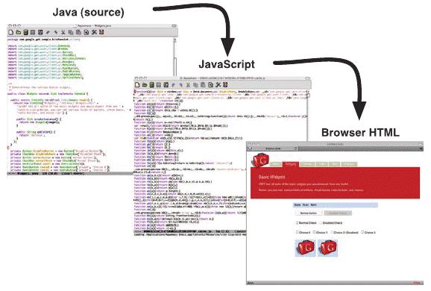
Cross compiler
Compiles Java to JavaScript
Code sources in GWT modules
Emulated classes with sources / emulated libraries
Good practices
Reduces final code size
Dead code removal
Shrinking
Optimized by closure compilator [optionaly]
Code obfuscation
Multiple versions of application
Client bundle
Perfect caching
Source: „GWT in Practice” Robert T. Cooper, Charlie E. Collins

Slide 17
Cross compiler Code obfuscation
Produced code can be formatted in three ways:
OBF – Obfuscated mode. This is a non-human-readable, compressed version suitable for production use.
PRETTY – Pretty-printed JavaScript with meaningful names.
DETAILED – Pretty-printed JavaScript with fully qualified names.
function A0(){this.B0();return this.js[0];}
function C0(){if(this.js.length > 1)
{this.js = [this.js.join('')];this.length = this.js[0].length;}}
function D0(E0){this.js = [E0];this.length = E0.length;}
function Ez(F0,a1){return F0.yx(yZ(a1));}
Obfuscated mode
function java_lang_StringBuffer_append__Ljava_lang
_String_2(toAppend){
var last = this.js.length - 1;
var lastLength = this.js[last].length;
if (this.length > lastLength * lastLength) {
this.js[last] = this.js[last] + toAppend;
}
function _append2(_toAppend){
var _last = this.js.length - 1;
var _lastLength = this.js[_last].length;
if (this.length > _lastLength * _lastLength) {
this.js[_last] = this.js[_last] + _toAppend;
}
Pretty mode
Detailed mode

Slide 18
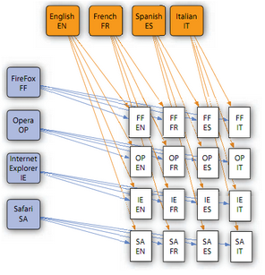
Cross compiler Multiple versions of application
Cross Compiler generates unique version of application (permutation) for every combination of:
Browser agent
Locale
Deffered Binding replacement rule
Reduces the size of the generated JavaScript code that a client will need to download by only including the code needed to run a particular browser/locale instance
Can create browser agent specific application
Source: „GWT in Practice” Robert T. Cooper, Charlie E. Collins

Slide 19
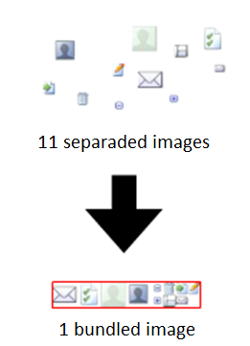
Cross compiler Client bundle
Allow to use resources through friendly interface
Support resources: Text, ExternalText, Image, CSS,
Features
Bundles
Large overhead
Useless freshness checks
Blocking HTTP connections
Caching
Notes:
Large overhead: In a standard web application, an HTTP request has to be sent to the server for each image. In many cases, those images are icons and the actual image size is very small. In that case, the size of the image is often smaller than the HTTP response header that is sent back with the image data. That means that most of the traffic is overhead and very little of it actual content.
Useless freshness checks: Traditional image handling is wasteful in other ways too. Even when the images have been cached by the client, a 304 ("Not Modified") request is still sent to check and see if the image has changed. Since images change infrequently, these freshness checks are also wasteful.
Blocking HTTP connections: Furthermore, HTTP 1.1 requires browsers to limit the number of outgoing HTTP connections to two per domain/port. A multitude of image requests will tie up the browser's available connections, which blocks the application's RPC requests. In most applications, RPC requests are the real work that the application needs to do.

Slide 20
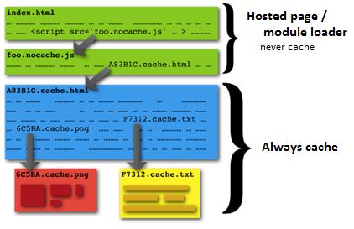
Cross compiler Caching
Perfect Caching allows the browser to cache resources forever and guarantees that changed resources are propagated immediately to the browser.
In GWT this is accomplished by naming a file like the hash code of its content.
Renaming
foo.css -> foo_39757cec04498955db62043f7ecfefc2.cache.css
logo.png -> logo_35bcdbbabe1944afc75eeeb16f06d1ad.cache.png
Update references in files
Replace all occurances of "foo.css" by "foo_55db62043f7ecfefc239757cec044989.cache.css"
Replace all occurances of "logo.png" by "logo_c75eeeb16f06d1ad35bcdbbabe1944af.cache.png"

Slide 21
Cross compiler overview

Slide 22
Building UI Overview
GWT user interface classes are similar to those in existing UI frameworks such as Swing and SWT except that the widgets are rendered using dynamically-created HTML rather than pixel-oriented graphics.
In traditional JavaScript programming, dynamic user interface creation is done by manipulating the browser's DOM. While GWT provides access to the browser's DOM directly using the DOM package, it is far easier to use classes from the Widget hierarchy. The Widget classes make it easier to quickly build interfaces that will work correctly on all browsers.
In module descriptor: <inherits name="com.google.gwt.user.User"/>
Native widgets: Button, PushButton, RadioButton, CheckBox, DatePicker, ToggleButton, TextBox, PasswordTextBox, TextArea, Hyperlink, ListBox, CellList, MenuBar, Tree, CellTree, SuggestBox, RichTextArea, FlexTable, Grid, CellTable, CellBrowser, TabBar, DialogBox
Native panels: PopupPanel, StackPanel, StackLayoutPanel, HorizontalPanel, VerticalPanel, FlowPanel, VerticalSplitPanel, HorizontalSplitPanel, SplitLayoutPanel, DockPanel, DockLayoutPanel, TabPanel TabLayoutPanel DisclosurePanel
Showcase: http://gwt.google.com/samples/Showcase/Showcase.html

Slide 23
Building UI Layout strategies: Java-based layout
Java-based layout
Attaches main layout panel to HTML <body> element
Java uses panels to build up overall layout
Similar to way LayoutManagers are used in desktop Java
<body>
<!-- Possibly history iframe, but few or no HTML elements -->
</body>
HTML
public void onModuleLoad() {
Panel panel = new FlowPanel();
Widget w1 = new Button(„Sample button1");
Widget w2 = new Button(„Sample button2");
Widget w3 = new Button(„Sample button3");
panel.add(w1);
panel.add(w2);
panel.add(w3);
RootPanel.get().add(panel);
}
JAVA

Slide 24
Building UI Layout strategies: Java-based layout
Pros
Dynnamic content
Safe typed
IDE support
Refactoring
Code completion
Debugging
All widgets support
Const
Hard to tell what the layout is exactly
Reading Java code is not easy to visualize
Very hard to effectively involve a graphic UI web designer
They usually don’t know Java
If they do, they are probably not good graphic designers (Kidding!)
Even if you manage to get the design into Java, very hard to maintain
Best when GWT is used to
Mimic a desktop application
Create an application where HTML layout changes on fly

Slide 25
Building UI Layout strategies: HTML-based layout
HTML-based layout
It’s mix of Java based layout with HTML placeholders
Write HTML by hand, designate places for individual controls
HTML body contains a lot of content
<body>
Regular HTML<div id="id-1"></div>
Regular HTML<div id="id-2"></div>
Regular HTML<div id="id-3"></div>
</body>
HTML
public void onModuleLoad() {
Widget w1 = new Button(„Sample button1");
RootPanel.get("id-1").add(w1);
Widget w2 = new Button(„Sample button2");;
RootPanel.get("id-2").add(w2);
Widget w3 = new Button(„Sample button3");;
RootPanel.get("id-3").add(w3);
}
JAVA

Slide 26
Building UI Layout strategies: HTML-based layout
Pros
Natural division of roles (view from controller)
Partially dynnamic content
Partially Safe typed
Partially IDE support
All widgets support
Const
Very hard do maintain
Very hard to extend
Not possible to reuse mixed components
Best when GWT is used for
A traditional Web app with some pieces of Ajax-enabled content
Complex page where HTML layout does not change
You need the HTML content indexed by a search engine

Slide 27
Building UI Layout strategies: UIBinder
UIBinder layout
Use XML to layout widgets and regular HTML
Designate fields within the XML layout for later binding
Use ui:field attribute in any XML or HTML element
Create Java-based counterpart of the XMLbased layout
Extends either Composite or UIObject
Designate counterpart class members to bind to the XML-based fields
Use @UiField annotation
Instruct GWT to bind the two components together

Slide 28
Building UI Layout strategies: UIBinder
<!DOCTYPE ui:UiBinder SYSTEM "http://dl.google.com/gwt/DTD/xhtml.ent">
<ui:UiBinder xmlns:ui="urn:ui:com.google.gwt.uibinder">
<div>Hello, <span ui:field="greetSpan" /></div>
</ui:UiBinder>
XML
public class HelloHtmlWorld extends UIObject {
interface HelloHtmlWorldUiBinder extends UiBinder<DivElement, HelloHtmlWorld> {}
private static HelloHtmlWorldUiBinder uiBinder = GWT.create(HelloHtmlWorldUiBinder.class);
@UiField
SpanElement greetSpan;
public HelloHtmlWorld(String greeting) {
setElement(uiBinder.createAndBindUi(this));
greetSpan.setInnerText(greeting);
}
}
JAVA
public void onModuleLoad() {
HelloHtmlWorld helloHtmlWorld = new HelloHtmlWorld("UiBinder HTML World!");
Element attachTo = RootPanel.get("uibinder-html").getElement();
attachTo.appendChild(helloHtmlWorld.getElement());
}
USE

Slide 29
Building UI Layout strategies: UIBinder
Pros
Complex web page layouts using HTML
Graphic UI web designers can be involved from initial design through maintanance
“Separation of concerns” - aesthetics and functionality of UI no longer mashed together
Browser Performance!
Const
Causes a bit of a file explosion in your project (there are two files for every component)
Unlike JSPs, UiBinder is only declarative
No rendering mechanism: no loops, conditionals
It’s just a declaration of your layout
Complex web page layouts using HTML!
Best when GWT is used for
Mimic a desktop application with simple rather static views
Create an application where UI designers are also involved

Slide 30
Java based layout sample

Slide 31
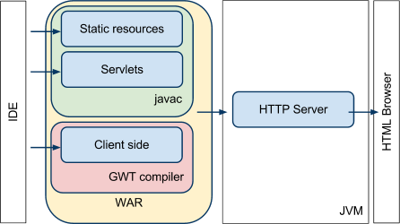
Productive support tools Production mode

Slide 32
Productive support tools Overview
Compilation process is heavy and time consuming process
Compilation process can be optimized / speed up:
Limit compilation permutations for development process:
Amount of browser agents
Amount of languages
Or use <collapse-all-properties />
Add compilation options in module descriptor:
draftCompile - Enable faster, but less-optimized, compilations
localWorkers - The number of local workers to use when compiling permutations
XdisableCastChecking - Disables run-time checking of cast operations
optimize - Sets the optimization level used by the compiler. 0=none 9=maximum
Use one of special mode:
Development mode
Super development mode

Slide 33
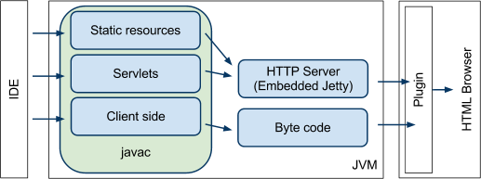
Productive support tools Development mode
It allows to run client side code without compilation to JavaScript
Code is hosted to HTML browser through plugin that translates bytecode directly
Plugin allows to debug code by traditional debugger
To run development mode with maven:
mvn gwt:run
mvn gwt:run –gwt.noserver=true
mvn gwt:debug
mvn gwt:debug –gwt.noserver=true

Slide 34
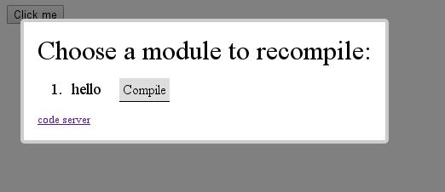
Productive support tools Duper development mode
It’s avaiable since 2.5, and will be replacement for Development Mode (under development)
Super Dev Mode runs the GWT compiler in a web server, which is an ordinary Java application that developers can run from the command line.
This web server provides the user interface for interacting with Super Dev Mode and also serves the GWT compiler's output. Super Dev Mode provides "Dev Mode On" bookmarklet. Clicking the bookmarklet shows a dialog that lists the GWT applications on the current page and allows you to compile them:

Slide 35
Comunication with server Overview
GWT offers many ways on the diffrent abstraction levels for comunication with server
Request Builder – a simple HTTP call (POST or GET) builder
GWT-RPC – most common comunication technology
RequestFactory – alternative for GWT-RPC due to GWT-RPC limitations
REST – thirdparty comunication way to comunicate with REST services
It is also possible to set up server push comunication with thirdparty libraries through:
WebSockets
Comet
DWR

Slide 36
Comunication with server Asynchronius Callback
Callback is a construction that allows to work in asynchronous way
Recomended usages:
using services that might last very long
response might never return to the recipient
Consequences when not used:
Application is on hold while waiting for response
UI is freezed
Sample: Comunication with server with HTTP protocol
Callback is implemented with AsyncCallback interface:
public interface AsyncCallback<T> {
void onFailure(Throwable caught); //Executed when call has been failed
void onSuccess(T result); //Executed when call has been completed successfully
}

Slide 37
Comunication with server Asynchronius Callback
void getMsgFromRemoteService(String messageToService, final AsyncCallback<String> callback) {
Timer serviceDelayTimer = new Timer() {
public void run() {
callback.onSuccess("Ended succesfully in 10 seconds");
}
};
serviceDelayTimer.schedule(10000);
}
Service implementation
public void executeAsyncService() {
getMsgFromRemoteService("Message for calling service", callback);
}
Service call
AsyncCallback<String> callback = new AsyncCallback<String>() {
public void onFailure(Throwable caught) {
Window.alert("Error:" + caught.getMessage());
}
public void onSuccess(String msgFromService) {
Window.alert(„Response:" + msgFromService);
}
};
Callback implementation

Slide 38
Comunication with server Overview
GWT offers many ways on the diffrent abstraction levels for comunication with server
Request Builder – a simple HTTP call (POST or GET) builder
GWT-RPC – most common comunication technology
RequestFactory – alternative for GWT-RPC due to GWT-RPC limitations
REST – thirdparty comunication way to comunicate with REST services
It is also possible to set up server push comunication with thirdparty libraries through:
WebSockets
Comet
DWR

Slide 39
Comunication with server GWT-RPC
GWT Remote Procedure Calls (GWT-RPC) – default and most common comunication way with server
The base of GWT-RPC is a webservice, that comunicates with server with HTTP protocol
Service is executed asynchroniously with automatic serialization i deserialization of transporting data
Models code is avaiable on client and server side
Transporting format is a reduced JSON
//OK[1985,8,7,5,'TwWa6OQ',4,'BCK',3,2,1961,6,5,3,'TwWa6OQ',4,'BCK',3,2,2,1,["[Lpl.pkosmowski.samplegwtapplication.client.Person;/1436811683","pl.pkosmowski.samplegwtapplication.client.Person/3269215620","java.lang.Long/4227064769","java.util.Date/3385151746","Nick","Furry","Black","Widow"],0,7]
Very easy to use
Very easy to work with other concepts like: ServletDispatcher, CommandPattern
Hard to use with non serializable objects / lists / maps
Lock vendor

Slide 40
Comunication with server GWT-RPC - example
Synchronous interface:
@RemoteServiceRelativePath("rpc/FeedService ")
public interface FeedModelRpc extends RemoteService {
public ArrayList<FeedModel> getAllFeeds();
}
Asynchronous interface:
public interface FeedModelRpcAsync {
public void getAllFeeds(AsyncCallback<ArrayList<FeedModel>> callback);
}
Implementacja po stronie serwerowej (serwlet susługi):
public class FeedServiceImpl extends RemoteServiceServlet implements FeedModelRpc {
@Override
public ArrayList<FeedModel> getAllFeeds() {
//logika biznesowa
}
}

Slide 41
Comunication with server GWT-RPC - example
Servlet mapping:
...
<servlet>
<servlet-name>FeedService</servlet-name>
<servlet-class>pl.pkosmowski.samplegt.server.FeedServiceImpl</servlet-class>
</servlet>
<servlet-mapping>
<servlet-name>FeedService</servlet-name>
<url-pattern>/MainModule/rpc/FeedService</url-pattern>
</servlet-mapping>
...

Slide 42
Comunication with server GWT-RPC - example
Callback:
private final AsyncCallback<ArrayList<FeedModel>> allFeedsCallback = new AsyncCallback<ArrayList<FeedModel>>() {
@Override
public void onFailure(Throwable caught) {
Info.display("Error", "An error has occured: " + caught.getMessage());
}
@Override
public void onSuccess(ArrayList<FeedModel> result) {
Info.display("Success result", "Got " + result.size());
}
};
Service factory with Defered Binding:
FeedModelRpcAsync service = GWT.create(FeedModelRpc.class);
service.getAllFeeds(allFeedsCallback);

Slide 43
Comunication with server Request Builder
Request Builder – adanced generic HTTP call builder
Allows to build HTTP call POST or GET
Might be used with any type of server (PHP, Perl), where any other comunication way is not possible
Hard to maintain as response must be manually parsed
public static void doPost(String url, HashMap<String,String> postData, final AsyncCallback<String> callback) {
RequestBuilder builder = new RequestBuilder(RequestBuilder.POST, url);
try {
builder.setHeader("Content-Type", "application/x-www-form-urlencoded");
builder.setTimeoutMillis(15000);
Request response = builder.sendRequest(encodeDataIntoUrl(postData), new RequestCallback() {
@Override
public void onResponseReceived(Request request, Response response) {
if (response.getStatusCode() == Response.SC_OK) {
callback.onSuccess(response.getText()); } else {
callback.onFailure(new Exception("Server response status: " +
response.getStatusText()));
} } });
} catch (RequestException e) {
callback.onFailure(e);
}}

Slide 44
Comunication with server RequestFactory
RequestFactory – GWT newest comunication way designed to work with non serializable collections
Use proxies instead direct objects
Use JSON format, transfers only changes, renders faster than GWT-RPC
Difficult
Server entity
Proxy for entity
@Entity
public class Person{
@Id
Long id; String name; String surname; String displayName;
@Version Integer version;
… }
@ProxyFor(value=Person.class, locator=PersonLocator.class) public interface PersonProxy extends EntityProxy{
String getDisplayName(); void setDisplayName(String displayName); Long getId(); void setId(Long id); String getName(); void setName(String name); String getSurname(); void setSurname(String surname); Integer getVersion(); void setVersion(Integer version);
Server
Client

Slide 45
Comunication with server RequestFactory
Repository of request services
public interface MainRequestFactory extends RequestFactory { PersonRf personRF(); }
Client
Service additional methods
@Service(value = PersonRFServiceImpl.class, locator=EntityLocator.class) public interface PersonRf extends RequestContext{
Request<List<PersonProxy>> getList(); }
Client
Service call
final MainRequestFactory rfService = GWT.create(MainRequestFactory.class); rfService.initialize(new SimpleEventBus(););
PersonRf personRfService = rfService.personRF(); personRfService.getList().to(new Receiver<List<PersonProxy>>() {
@Override public void onSuccess(List<PersonProxy> result) { //do something with results } }); personRfService.fire();
Client

Slide 46
Comunication with server RequestFactory
public class PersonLocator extends Locator<Person, Long> {
public Person create(Class<? extends Person> clazz) { return new Person(); } public Person find(Class<? extends Person> clazz, Long id) { return
DAO.findPersonById(id); }
public Class<Person> getDomainType() { return Person.class; }
public Long getId(Person domainObject) { return domainObject.getId(); } public Class<Long> getIdType() { return Long.class; } public Object getVersion(Person domainObject) { return -1; } }
Server
public class PersonRFServiceImpl {
public List<Person> getList() { return DAO.getList(); } }
Server
Two types of proxies:
Entity proxy
Value proxy

Slide 47
Comunication with server How to persist data with GWT?
GWT-RPC requires from transported objects to be serializable,
Persistable objects that contains relations are not serializable,
ORM frameworks uses lazy initialization collections / sets / maps
Transport methods:
DTO
Gilead
Non ORM persistence frameworks
Pure JDBC
SpringJDBC
MyBatis
RequestFactory

Slide 48
Comunication with server How to persist data with GWT?
Copying data from DTO to model:
Copying data from model to DTO:
public Record(RecordDTO record) {
id = record.getId();
title = record.getTitle();
year = record.getYear();
price = record.getPrice();
}
private RecordDTO createRecordDTO(Record record) {
return new RecordDTO(record.getId(), record.getTitle(), record.getYear(), record.getPrice());
}
Schematic introduction of DTO method:
Client side
Server side
DB
Processing
DTO
Model
Processing

Slide 49
Another features Not mentioned
Use external libraries
Code splitting
Internationalisation
Junit Testing
History support
JSNI
Deffered Binding
Editors
Validation
Logging
HTML5 support / Elementals
Cross scripting
Security
Safe HTML
XSRF protection
Activities and Places
ARIA support
Spring STS and ROO
Notes:
import com.google.gwt.core.client.EntryPoint;
import com.google.gwt.user.client.ui.RootPanel;
import com.sencha.gxt.data.shared.StringLabelProvider;
import com.sencha.gxt.widget.core.client.FramedPanel;
import com.sencha.gxt.widget.core.client.button.TextButton;
import com.sencha.gxt.widget.core.client.container.MarginData;
import com.sencha.gxt.widget.core.client.container.VerticalLayoutContainer;
import com.sencha.gxt.widget.core.client.container.Viewport;
import com.sencha.gxt.widget.core.client.form.DateField;
import com.sencha.gxt.widget.core.client.form.FieldLabel;
import com.sencha.gxt.widget.core.client.form.SimpleComboBox;
import com.sencha.gxt.widget.core.client.form.TextField;
/**
*
* @author Kosmo
*/
public class MainEntryPoint implements EntryPoint {
@Override
public void onModuleLoad() {
Viewport viewport = createVievport();
RootPanel.get().add(viewport);
}
private Viewport createVievport() {
final Viewport viewport = new Viewport();
FramedPanel frame = createFrame();
viewport.add(frame, new MarginData(25));
return viewport;
}
private FramedPanel createFrame() {
final FramedPanel frame = new FramedPanel();
VerticalLayoutContainer verticalPanel = createVerticalPanel();
frame.setWidget(verticalPanel);
return frame;
}
private VerticalLayoutContainer createVerticalPanel() {
final VerticalLayoutContainer verticalPanel = new VerticalLayoutContainer();
verticalPanel.add(new FieldLabel(new TextField(), "Text"));
verticalPanel.add(new FieldLabel(new DateField(), "Date"));
verticalPanel.add(new FieldLabel(new SimpleComboBox(new StringLabelProvider()), "Combo"));
verticalPanel.add(new TextButton("Submit"));
return verticalPanel;
}
}

Slide 50
GWT ecosystem
Tools
IDE Plugins – GWT Plugin 4 Eclipse and GWT4NB
Editor – GWT Designer, on-line designers
Speed Tracer
Connected projects / popular libraries
Vadin – Build on top of GWT but most logic is executed on server
Ext GWT or GXT – native UI library for GWT from Sencha – port of ExtJS
Errai – JBoss framework based on GWT with JEE addons
Enterprise patterns for GWT
GIN – dependency injection for client side
MVP4G / GWTP – MVP frameworks
Command pattern for GWT – encapsulates logic
Integration with popular frameworks
JEE
Spring Framework
Guice

